Slide 1
INFO215: Week 2b Sociotechnical Approaches: Key Ideas

Slide 2
Bowker & Star
What is their point?
Why did I ask you to read about classification?

Slide 3
Wong et al
What is Infrastructural Speculation?
Why does it matter?
What did you take away from this reading?

Slide 4
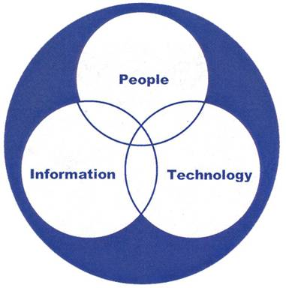
Some key sociotechnical ideas
Adoption curves
Hype cycles
Unintended consequences
Productivity paradoxes
Technopanics
Utopias and dystopias (to be discussed in a future class session)

Slide 5
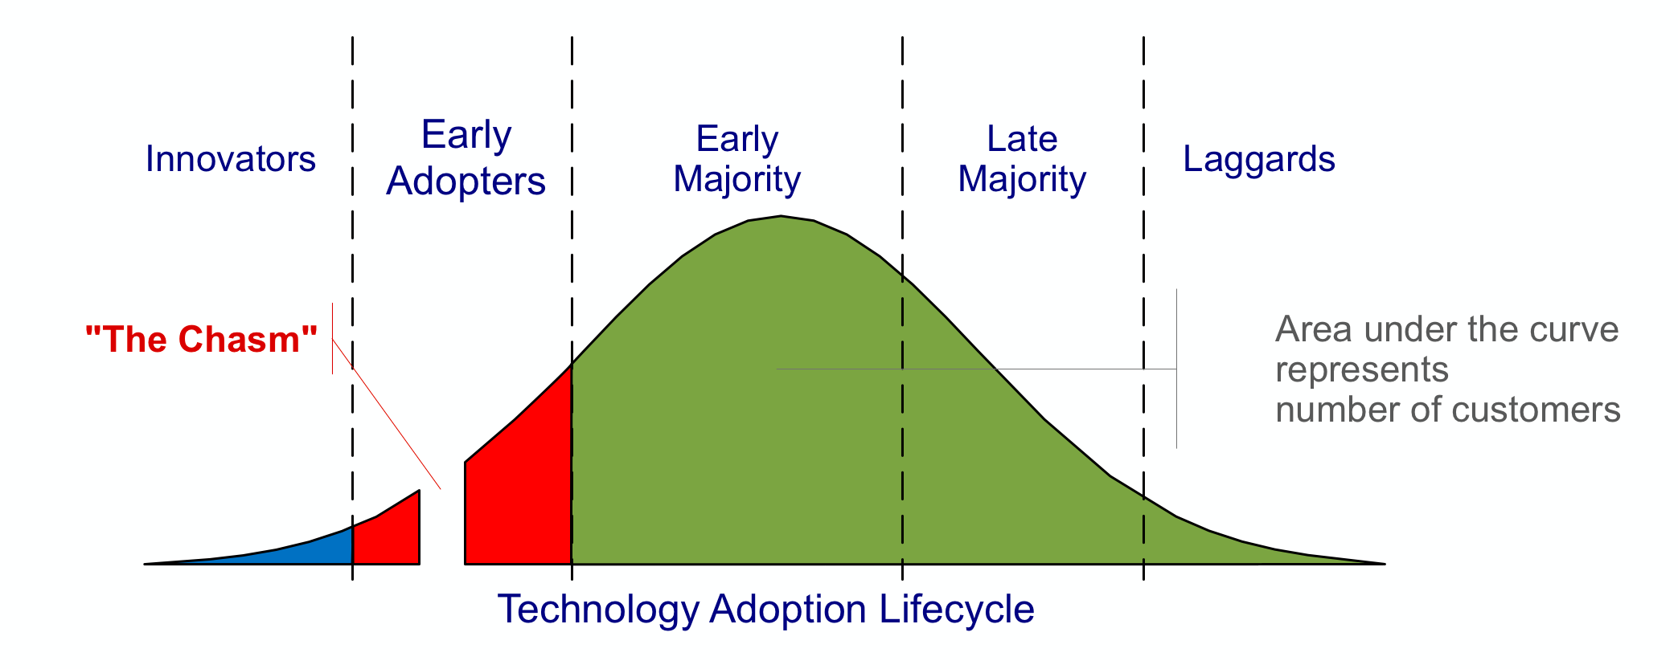
Adoption Curves (1957) and Chasms (1991)
Moore, G. (2014). Crossing The Chasm. Harper Business Essentials
Notes:
Chasm = a gap between the first two adopter groups (innovators/early adopters), and the vertical markets

Slide 6
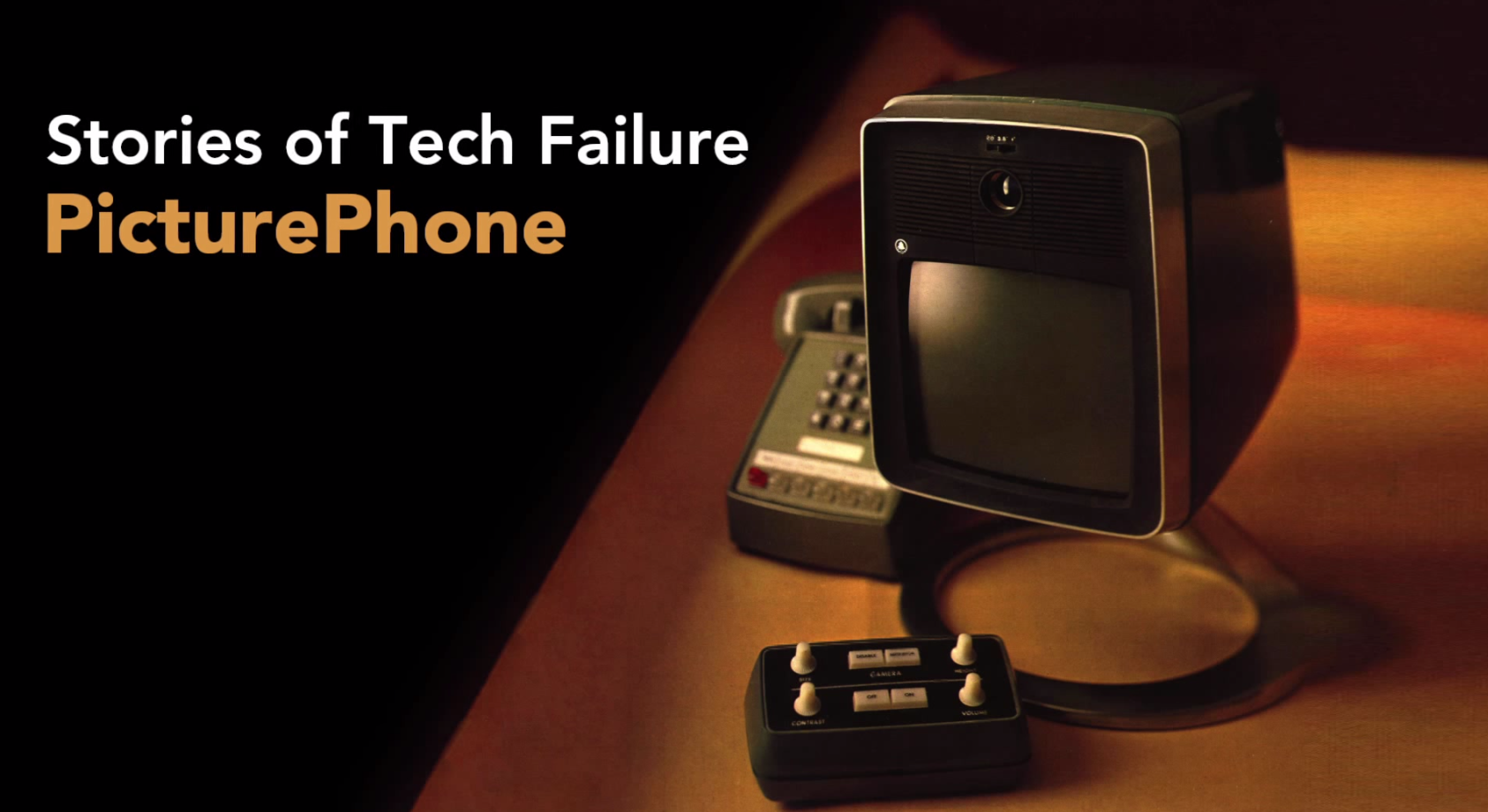

https://www.youtube.com/watch?v=WzdCKBZP4Jo

Slide 7
Discussion
What were the adoption “chasms” for the picture phone?
How could its design have been improved?

Slide 8
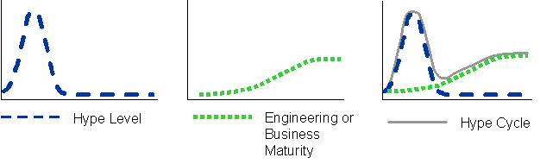
Hype Cycle (Gartner, 1995)

Slide 9
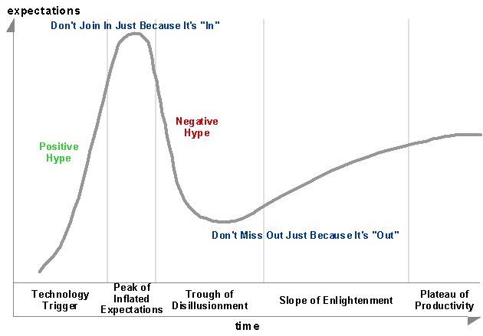

Slide 10
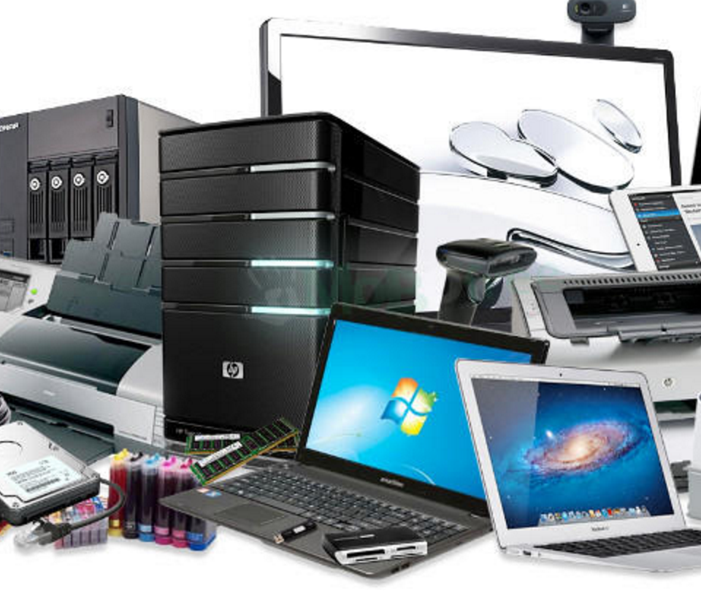
The Technology Obsolescence Chain: Planned Obsolescence
https://www.youtube.com/watch?v=4Z1XYM7bC4k
(stop at 6:90)

Slide 11
The Technology Obsolescence Chain: Perceived Obsolescence
https://youtu.be/N2KLyYKJGk0?t=74

Slide 12

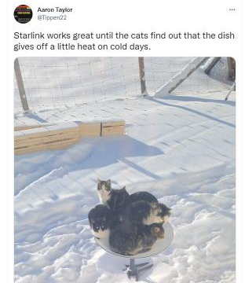

Unintended Consequences/Uses of Technology and Design
Unintended consequences and uses can be desirable or undesirable. Other examples?

Slide 13



Mobile devices have led to new behaviors that affect others and that necessitate new policies and legislation.
http://mrticketsd.com/fight-traffic-tickets-in-san-diego-ca/cell-phone-tickets-california/

Slide 14
Productivity Paradox (“The Solow Computer Paradox)
Apparent failure of computer/IT investment to produce productivity gains
“You can see the productivity age everywhere but in the productivity statistics” – Robert Solow, 1987
In the 1970s and 1980s, computing power exploded (~10,000%), yet industrial productivity slowed from 3% to 1%.
QUESTION: Why on earth did this happen?!?

Slide 15
Understanding the Productivity Paradox
https://www.wnyc.org/story/understanding-the-productivity-paradox/

Slide 16
Productivity Paradox (“The Solow Computer Paradox”)
Main causes:
Poor implementation
Systems did not support work practices.
Underestimation of amount of work required to extract value from new systems.

Slide 17

Technopanics (Marwick, 2008)
(1) focus on new media forms
(2) pathologize young people’s use of the media
(3) result in an attempt to modify or regulate young people’s behavior
Marwick A (2008) To catch a predator? The MySpace moral panic. First Monday, Available at: http://journals.uic.edu/ojs/index.php/fm/article/view/2152/1966
This image always makes me laugh.

Slide 18
Technopanics (Marwick, 2008)
Think of an information medium or platform that is popular with young people.
Consider each of the three parts of the theory of technopanics. Does each part apply to the medium or platform that you chose? Why or why not?
-------------------------
(1) focus on new media forms
(2) pathologize young people’s use of the media
(3) result in an attempt to modify or regulate young people’s behavior
Marwick A (2008) To catch a predator? The MySpace moral panic. First Monday, Available at: http://journals.uic.edu/ojs/index.php/fm/article/view/2152/1966

